Slide 1
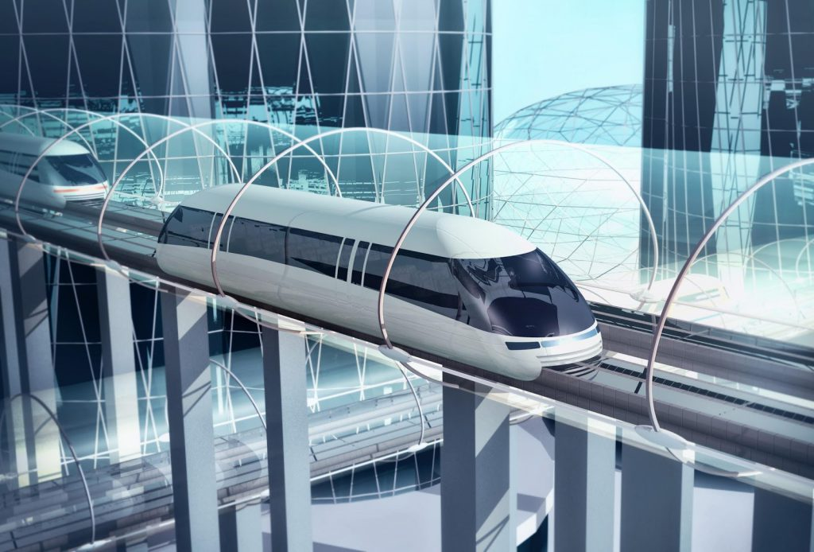
HYPERLOOP: NEW MODE OF TRANSPORTATION
PRESENTED BY:
GOWRI KRISHNA K S
S6 BCA
REG NO:210021092553
DEPARTMENT OF COMPUTER SCIENCE

Slide 2
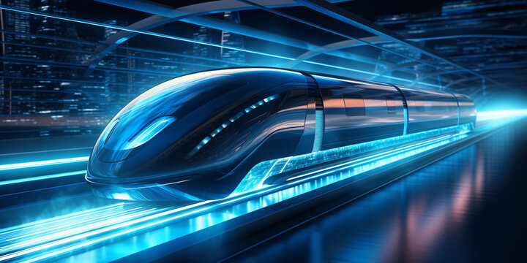
WELCOME

Slide 3
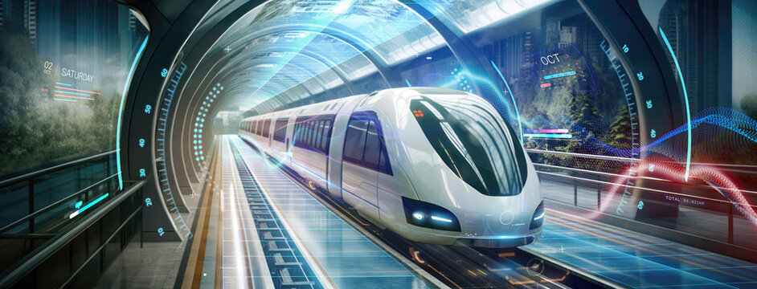
INTRODUCTION
HYPERLOOP IS A PROPOSED HIGH-SPEED TRANSPORTATION SYSTEM FOR BOTH PASSENGERS AND FREIGHT. THE CONCEPT WAS DOCUMENTED BY ELON MUSK IN A 2013 WHITE PAPER, WHERE THE HYPERLOOP WAS DESCRIBED AS A TRANSPORTATION SYSTEM USING CAPSULES SUPPORTED BY AN AIR-BEARING SURFACE WITHIN A LOW-PRESSURE TUBE.[1] HYPERLOOP SYSTEMS HAVE THREE ESSENTIAL ELEMENTS: TUBES, PODS, AND TERMINALS.

Slide 4
HISTORY OF HYPERLOOP
Hyperloop was teased by Elon Musk at a 2012 speaking event, and described as a "fifth mode of transport".[3] Musk released details of an alpha-version in a white paper in August 2013, in which the hyperloop design incorporated reduced-pressure tubes with pressurized capsules riding on air bearings driven by linear induction motors and axial compressors.
The hyperloop concept has been promoted by Musk and SpaceX, and other companies or organizations were encouraged to collaborate in developing the technology.

Slide 5
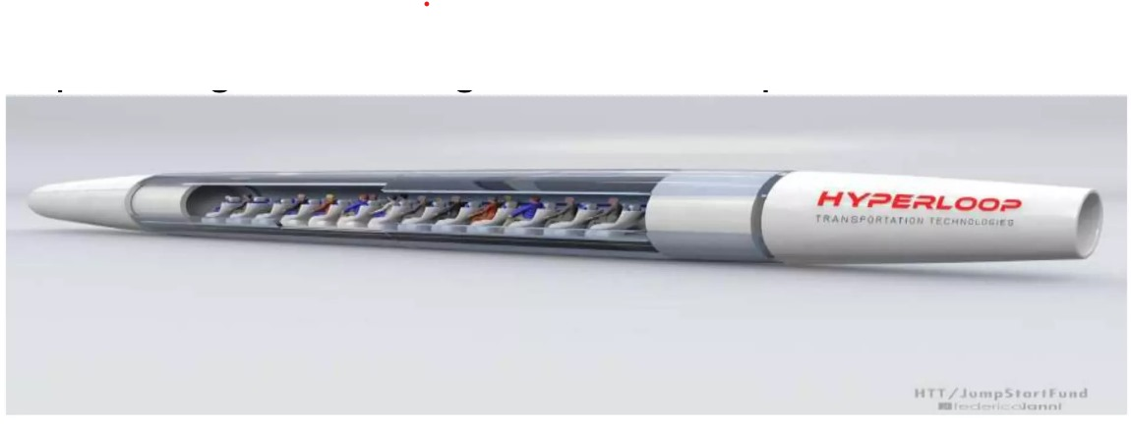
WHAT IS HYPERLOOP
HYPERLOOP IS A MODE OF PASSENGER AND GOODS AND TRANSPORTATION THAT PROPELS A CAPSULE LIKE VEHICLE THROUGH A NEAR VACUUM TUBE AT MORE THAN AIRLINE SPEED.
HYPERLOOP IS CURRENTLY IN DEVELOPMENT BY A NUMBER OF COMPANIES , WHICH COULD SEE PASSENGER TRAVELLING AT 1200 KM PER HOUR .

Slide 6
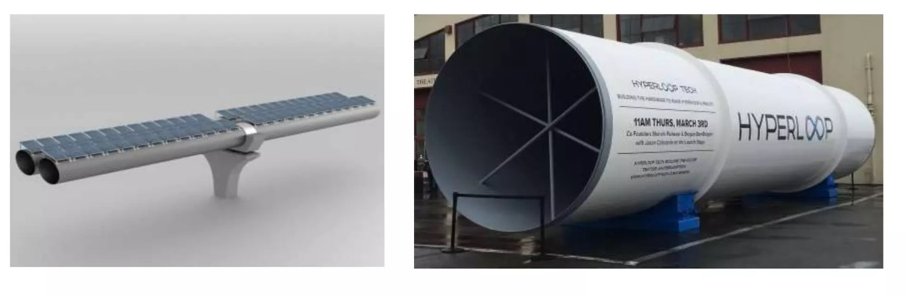
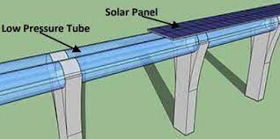
SYSTEM MODELING
TUBE:
THE TUBE IS MADE OF STEEL. TWO TUBES WILL BE WELDED TOGETHER IN A SIDE CONFIGURATION TO ALLOW THE CAPSULE TO TRAVEL BOTH DIRECTIONS.
THE SOLAR ARRAY ARE PROVIDED ON THE TOP OF THE TUBES TO POWER THE SYSTEM.

Slide 7
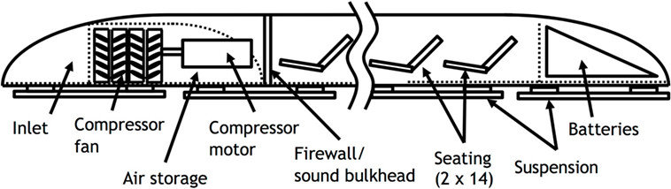
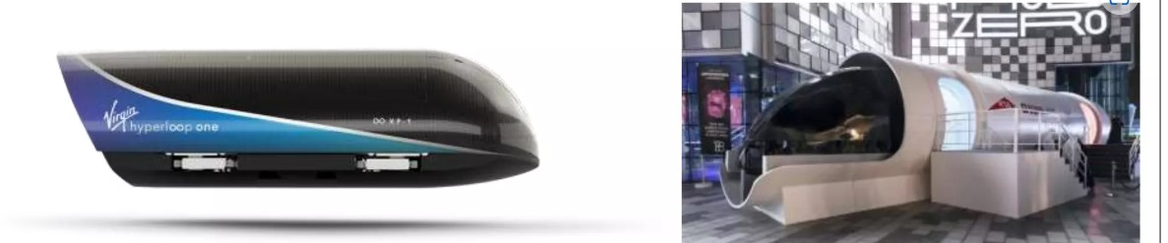
2)CAPSULE/POD:
CAPSULE ARE USED TO CARRY PASSENGERS AND GOODS ‘
THESE CAPSULE ARE SHAPED AERODYNAMICALLY TO REDUCE THE TAG’
THE CAPSULE CAN CARRY 28 PASSENGERS AT THE SAME TIME.
CAPSULES ARE DESIGNED WITH LATEST TECHNOLOGIES AND HOUSES NEW FORM OF GADGETS FOR THE COMFORT.

Slide 8
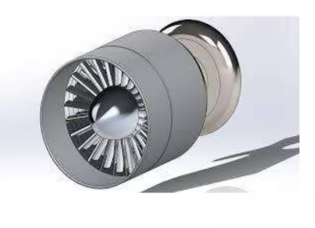
3)COMPRESSOR:
COMPRESSOR IS PLACED AT THE PART OF THE CAPSULE.
COMPRESSOR FANS SUCKS THE LOW PRESSURE AIR.AFTER COMPRESSION,COMPRESSED AIR IS SUPPLIED TO THE AIR BEARINGS AND ALSO AT THE REAR END OF THE CAPSULE.

Slide 9
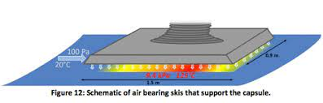
4)SUSPENSION:
AIR BEARINGS ARE USED SUSPENSION FOR THE CAPSULE
THE AIR BEARING SUSPENSION OFFERS STABILITY TO THE CAPSULE.
THE AIR BEARING SUSPENSION ALSO PROVIDE RELIABILITY AND SAFETY.

Slide 10
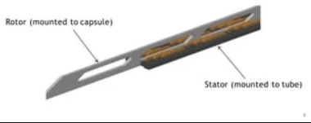
5)PROPULSION:
CAPSULE HOUSES LINEAR INDUCTION MOTOR ALONG THE LENGTH TO ACCELERATE AND DECELERATE .
LINEAR STATORS ARE PLACED ON THE CAPSULE TO TRANSFER MOMENTUM TO THE CAPSULE VIA LINEAR ACCALERATORS.

Slide 11
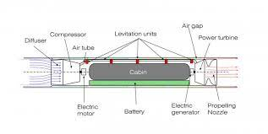
WORKING OF THE HYPERLOOP
HYPERLOOPS WORKS ON THE PRINCIPLE OF MAGNETIC LEVITATION.
THE CAPSULES MOVES IN THE LOW PRESSURE PYLON SUPPORTED TUBE.
THE LOW PRESSURE AIR IS SUCKED BY THE COMPRESSOR ,CONVERTS IT INTO HIGH PRESSURE AIR AND EJECTS IT THROUGH THE AIR BEARINGS AND AT REAR AND NOZZLES TO GET EXTRA FORWARD.

Slide 12
ENERGY,ENVIORNMENT & ECONOMIC CONCERN
HYPERLOOP ITSELF RUNS ON RENEWABLE ENERGIES LIKE SOLAR,WIND,AND THERMINALPOWER.
LESS POWER CONSUMPTION.
NOT POSSIBLE TO POLLUTE
LONG SERVICE LIFE AND LOW MAINTENANCE.

Slide 13
TEST COST
ACCORDING TO THE STUDY THE GREATE LAKES HYPERLOOP WILL COST BETWEEN $25 BILLION AND $30 BILLION OR $60 MILLION PER MILE.
IN INDIA ESTABLISHING HYPERLOOP IS COST –INTENSIVE . GOING AHEAD,PER KM COST OF THE HYPERLOOP WOULD BE SOMEWHERE AROUND INR 150 CRORE.

Slide 14
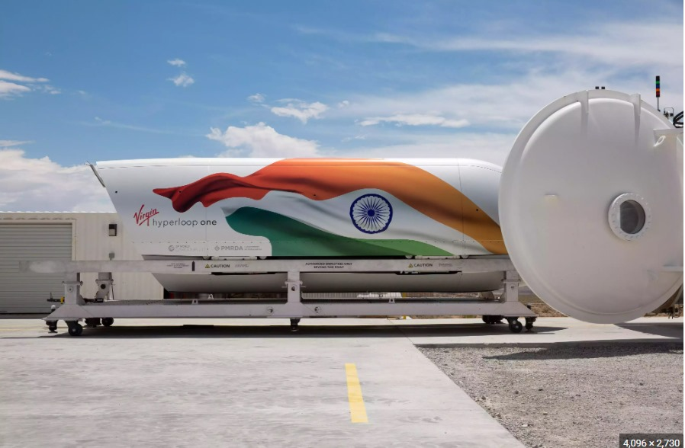
HYPERLOOP IN INDIA
PROJECTS HAVE BEEN APPROVED BY THE INDIAN GOVERNMENT FOR CONSTRUCTING THE HYPERLOOP FOR THE ROUTES BETWEEN
AMRAVATHI TO VIJAYAVADHA
MUMBAI TO CHENNAI
BENGULURU TO CHENNAI
MUMBAI TO PUNE

Slide 15
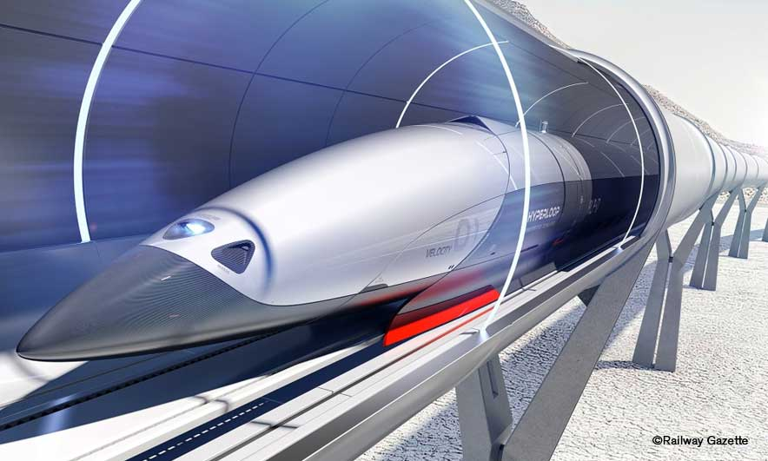
COMPANIES WORKING FOR HYPERLOOP
VIRGIN HYPERLOOP
HYPERLOOP TT
SPACEX ELON MUSK HYPERLOOP

Slide 16
APPLICATIONS IN THE FIELD OF TRANSPORTATION
HYPERLOOP OPENS POSSIBILITY FOR CROSS PROVINCIAL STUDENT TO GO HOME FOR THE WEEKEND THAT MAKES HOUR LONG TRAVEL WITHIN MINUTES.
HYPERLOOP NOT ONLY USED FOR HUMAN TRANSPORT BUT ALSO USED FOR DISTRIBUTION OF GOODS.
CROSS COUNTRY DELIVERIES WILL BE DONE IN HOURS.

Slide 17
ADVANTAGES OF HYPERLOOP
HIGH SPEED
QUICK AND FREQUENT TRAVEL
ENERGY EFFICIENCY
CHEAPER MODE OF TRANSPORTATION
SUSTAINABILITY
IMMUNE TO DISASTERS

Slide 18
DISADVANTAGES OF HYPERLOOP
CHANCES OF FAILURE ARE THE THREATENING
THE HUMAN FACTOR
STEEL TRACKS WILL EXPAND DUE TO THERMAL EXPANSION
PRONE TO DELIBERATE ATTACKS

Slide 19
CONCLUSION
HYPERLOOP TRANSPORTATION SYSTEM CAN BE USED OVER THE CONVENTIONAL MODES OF TRANSPORTATION THAT ARE RAIL,ROAD,WATER AND AIR.
AT VERY HIGH SPEED IT PROVIDES BETTER COMFORT AND COST IS ALSO LOW.
BY REDUCING THE PRESSURE OF THE AIR IN THE TUBE WHICH REDUCE SIMPLE AIR DRAG AND ENABLES THE CAPSULE TO MOVE FASTER.
EVEN TAKING DEMERITS INTO ACCOUNT , HYPERLOOP STILL PROVES TO BE A DYNAMIC TRANSPORTATION MODE FOR THE FUTURE.

Slide 20
FUTURE SCOPE
MORE EXPANSION ON THE CONTROL MECHANISM FOR HYPERLOOP CAPSULE ,INCLUDING ATTITUDE THRUSTER OR CONTROL MOMENT GYROS.
DETAILED STATION DESIGN WITH LOADING AND UNLOADING OF BOTH PASSENGER AND PASSENGER PLUS VEHICLE VERSIONS OF THE HYPERLOOP CAPSULE.
TRADE COMPARING THE COSTS AND BENEFITS OF HYPERLOOP WITH MORE CONVENTIONAL MAGNETIC LEVITATION SYSTEMS.
SUB-SCALE TESTING BASED ON A FURTHER OPTIMIZED DESIGN TO DEMONSTRATE THE PHYSICS OF HYPERLOOP.

Slide 21
THANK YOU

Slide 22
ANY QUERIES ?

